Slide 1
Objectives for today
Motivate prediction: what’s y_hat? What’s beta_hat?
Finish discussing Pandas -- .loc and .iloc
This is a numpy-like way to get data from a dataframe
Logical indexing
This is a way to ”condition” what data you pull from a dataframe
Introduce data manipulation tools:
Merge, Groupby
This are even more powerful ways to get data from your dataframe

Slide 2
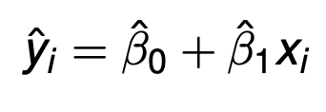
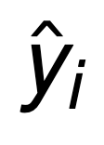
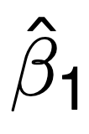
Recap – key concept from lecture 2
Prediction versus inference (y versus β)
is a prediction of a target variable
infers a relationship between two variables
Notes:
Big data: many fields, or features, per data point. I.e. the data are both numerous and WIDE

Slide 3
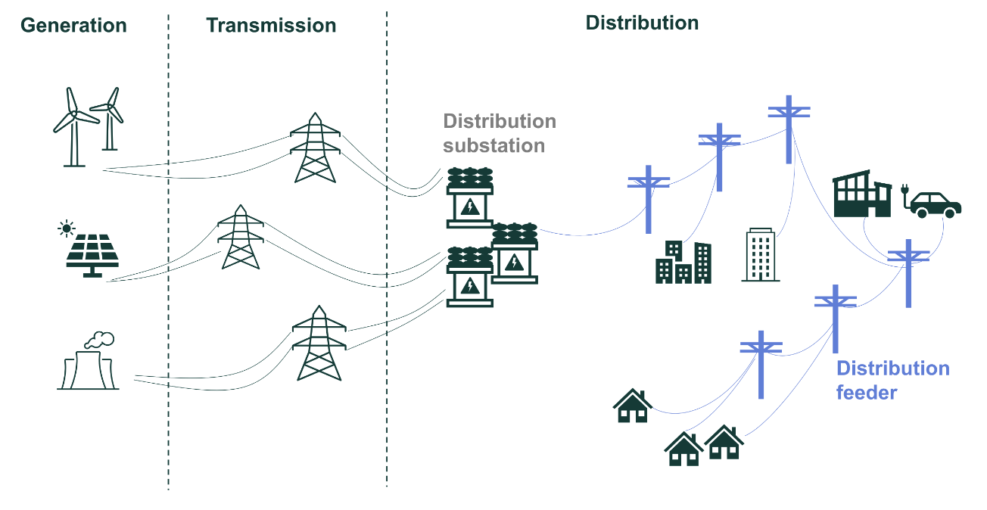
Side note: Electricity infrastructure

Slide 4
Example problem: Prediction or inference?
Researchers at UC Berkeley are studying PG&E’s wildfire mitigation efforts in distribution feeders. They have data on (i) the time and location of historical wildfire ignitions caused by PG&E’s feeders, (ii) daily weather, (iii) data on vegetation conditions near each feeder, and (iv) the characteristics of PG&E’s electrical system. They also have data on the timing and location of PG&E’s wildfire mitigation actions (e.g. tree trimming, burying lines, and covering wires with insulation so falling trees don’t spark). They use all this data to calculate how much each type of wildfire mitigation action reduced the risk of ignitions in PG&E’s network. They then present their findings to PG&E, explaining which mitigation action has the greatest ability to reduce wildfire rates.

Slide 5
Example problem: Prediction or inference?
This is inference because researchers are identifying the relationship between ignitions and efforts to prevent them.

Slide 6
Some terminology: Prediction
The target variable is the thing you’re trying to predict
The features are the data you have to make the prediction
Which is which in the following?
yhat: target
x: feature
More terminology: i indexes each observation. A location, a person, a community. Those could be observed at many different times.

Slide 7
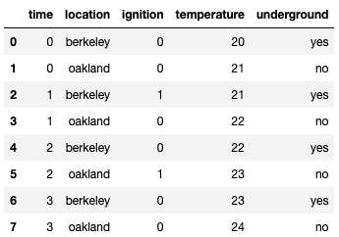
What’s an observation in this dataframe?
Notes:
Observation: a row

Slide 8
Prediction with PG&E data
Suppose we use the same data as in the prior example to predict when and where the next wildfire ignition will be.
We have data on
the time and location of historical wildfire ignitions caused by PG&E’s feeders
daily weather
data on vegetation conditions near each feeder
the characteristics of PG&E’s electrical system
the timing and location of PG&E’s wildfire mitigation actions
What is the target?
Whether or not an ignition occurred at a time and location on PG&E’s grid
data could be structured as 0 or 1 for each location / time pair
What are the features?
everything else!
What constitutes an observation?
For a specific time and location, the value of both the target variable and the features.

Slide 9
Example dataframe, again
Notes:
Observation: a row

Slide 10
Let’s work with jupyter notebooks
First, we’ll do .loc and .iloc
Second, we’ll work on logical indexing
Then we’ll come back to the slide deck

Slide 11
Merge
(Credit to Joey Gonzales and Fernando Perez)

Slide 12
Joining two tables
OrderNum | ProdID | Name
1 | 42 | Gum
2 | 999 | NullFood
2 | 42 | Towel
OrderId | Cust Name | Date
1 | Joe | 8/21/2017
2 | Arthur | 8/14/2017
x
Left “key”
Right “key”
OrderNum | ProdID | Name | OrderId | Cust Name | Date
1 | 42 | Gum | 1 | Joe | 8/21/2017
1 | 42 | Gum | 2 | Arthur | 8/14/2017
2 | 999 | NullFood | 1 | Joe | 8/21/2017
2 | 999 | NullFood | 2 | Arthur | 8/14/2017
2 | 42 | Towel | 1 | Joe | 8/21/2017
2 | 42 | Towel | 2 | Arthur | 8/14/2017
Drop rows that don’t match on the key

Slide 13
Joining two tables
OrderNum | ProdID | Name
1 | 42 | Gum
2 | 999 | NullFood
2 | 42 | Towel
OrderId | Cust Name | Date
1 | Joe | 8/21/2017
2 | Arthur | 8/14/2017
x
Left “key”
Right “key”
OrderNum | ProdID | Name | OrderId | Cust Name | Date
1 | 42 | Gum | 1 | Joe | 8/21/2017
1 | 42 | Gum | 2 | Arthur | 8/14/2017
2 | 999 | NullFood | 1 | Joe | 8/21/2017
2 | 999 | NullFood | 2 | Arthur | 8/14/2017
2 | 42 | Towel | 1 | Joe | 8/21/2017
2 | 42 | Towel | 2 | Arthur | 8/14/2017
Drop rows that don’t match on the key
OrderNum | ProdID | Name | OrderId | Cust Name | Date
1 | 42 | Gum | 1 | Joe | 8/21/2017
2 | 999 | NullFood | 2 | Arthur | 8/14/2017
2 | 42 | Towel | 2 | Arthur | 8/14/2017
Notes:
Note this type of merge is an “inner” merge. Later in the course we’ll talk about outer, left, and right merges.

Slide 14
Merge types
Inner: only keep the rows where the keys match
Right:
Keep all the right dataframe rows.
Populate rows that didn’t have match from the left dataframe with NaN
Left – like right, but keep left dataframe rows…
Outer:
Keep all rows
Populate rows that don’t have matching keys with NaN.

Slide 15
Let’s try this in a jupyter notebook
We’ll come back to this slide deck in a bit to talk about Groupby

Slide 16
Groupby

Slide 17
Manipulating Granularity: Group By
Key
Data
A
A
3
3
B
B
1
1
C
C
4
4
A
A
1
1
B
B
5
5
C
C
9
9
A
A
2
2
B
B
6
6
C
C
5
5

Slide 18
Manipulating Granularity: Group By
Key
Data
A
3
A
3
A
1
B
B
1
1
A
2
C
C
4
4
A
1
B
B
5
5
C
C
9
9
A
2
B
B
6
6
C
C
5
5

Slide 19
Manipulating Granularity: Group By
Key
Data
A
3
A
3
A
1
B
1
A
2
C
4
A
1
B
1
Split into
Groups
B
5
B
5
C
9
B
6
A
2
C
4
B
6
C
9
C
5
C
5

Slide 20
Manipulating Granularity: Group By
Key
Data
A
3
A
3
Aggregate
Function
A
A
6
A
1
6
B
1
A
2
C
4
A
1
B
1
Split into
Groups
Aggregate
Function
B
B
12
B
5
B
5
12
C
9
B
6
A
2
C
4
B
6
Aggregate
Function
C
9
C
C
18
18
C
5
C
5

Slide 21
Manipulating Granularity: Group By
Key
Data
A
3
A
3
A
1
Aggregate
Function
A
6
B
1
A
2
C
4
A
6
A
1
B
1
Split into
Groups
Put Results
in DataFrame
B
12
B
5
B
5
Aggregate
Function
B
12
C
18
C
9
B
6
A
2
C
4
B
6
Aggregate
Function
C
9
C
18
C
5
C
5

